Slide 1
Types of Promotion
Chapter 17.2

Slide 2
How have you been persuaded to buy products? or informed to buy new products?
Many promotions create customer excitement and/or increase sales!

Slide 3
Sales Promotions
Incentives that encourage customers to buy products or services

Slide 4
Two types of sales promotion
Trade Promotions
Consumer Promotions
Sales promotion activities designed to get support for a product from manufacturers, wholesalers, and retailers
Sales strategies that encourage customers & prospects to buy a product or service.

Slide 5
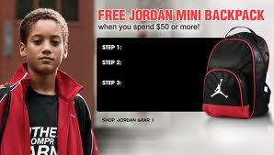
Trade Promotions
Promotional Allowances
Payments or discounts given by manufacturers to retailers for performing activities that encourage sales
Example:
Foot Locker gets the new Jordan sneakers at a discount from Nike as long as they promote those kicks over others.

Slide 6
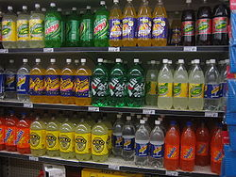
Trade Promotions cont.
Cooperative Advertising
A manufacturer helps a retailer by paying for the cost of advertising it’s product locally.
Slotting Allowance
Cash premium paid by manufacturer to retailer to help the retailer cover the costs of placing the products on the shelves.
$$$$$$$$
$$

Slide 7
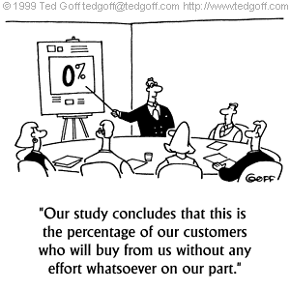
Trade Promotions cont.
Sales force promotions
Awards given to employees who successfully exceed sales quota

Slide 8
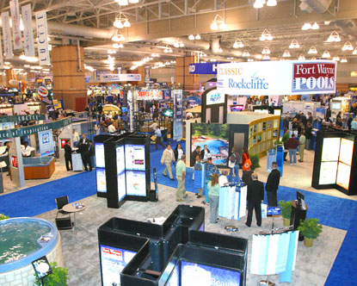
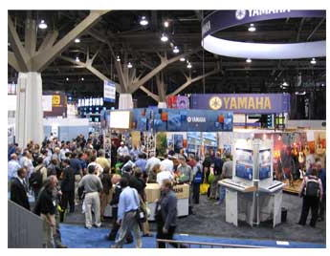
Trade promotions cont.
Trade shows & conventions
Showcase a particular line of products

Slide 9
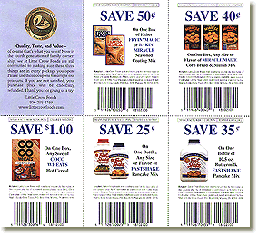
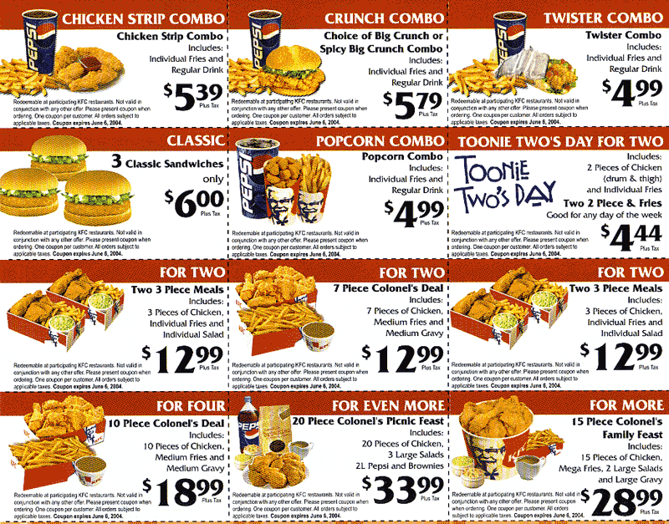
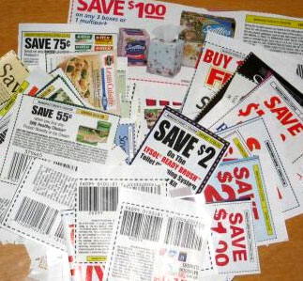
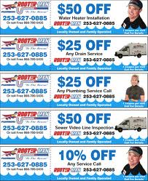
Consumer Promotions
Coupons
Certificates that entitles customers to cash discounts on goods or services

Slide 10
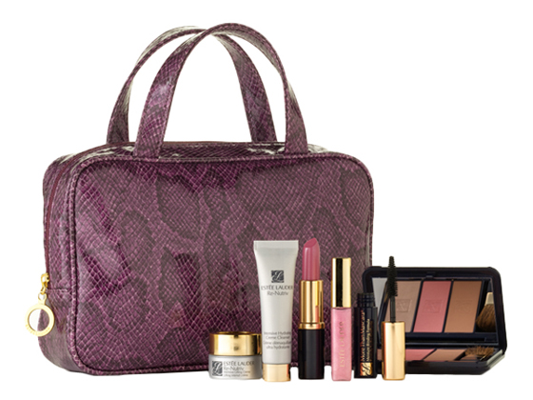
Consumer promotions cont.
Premiums
Low cost items given to consumers at a discount or free

Slide 11
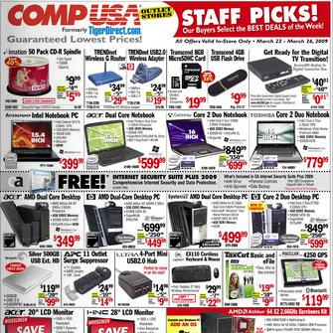
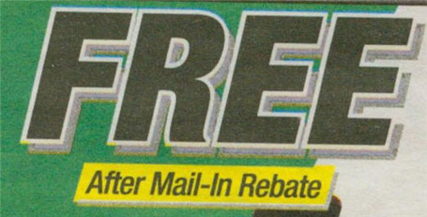
Consumer promotions cont.
Deals
Short term price reductions marked directly on label or package
Incentives
Products earned through giveaways, sweepstakes, rebates.

Slide 12
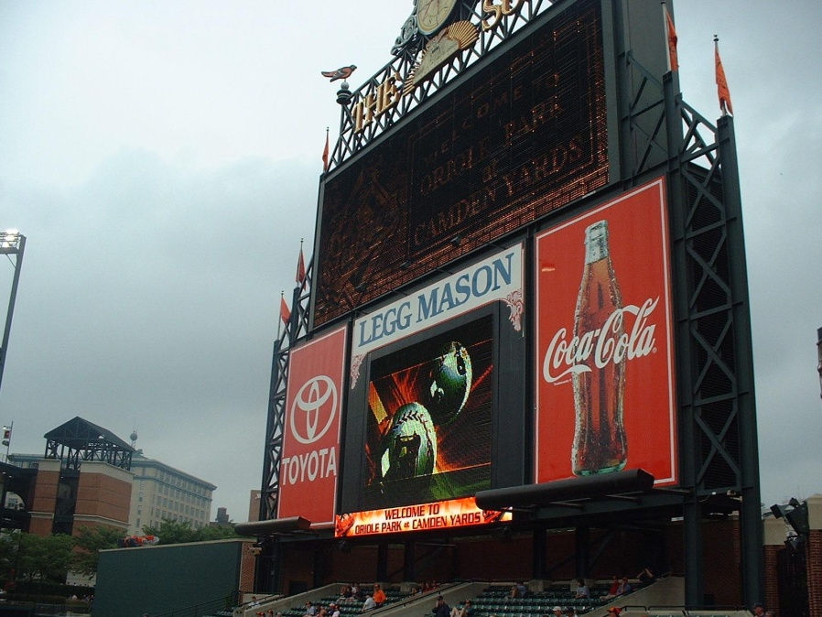
Consumer promotions cont.
Product Samples
Sponsorship

Slide 13
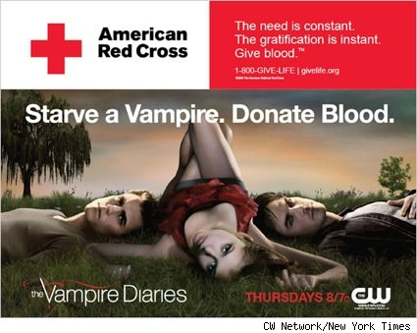
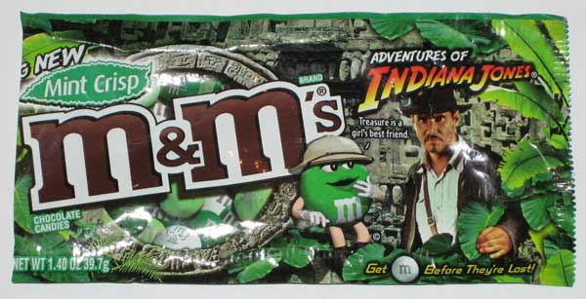
Consumer promotions cont.
Promotional tie-ins, cross-promotion
Sales promotional arrangements by more than one retailer

Slide 14
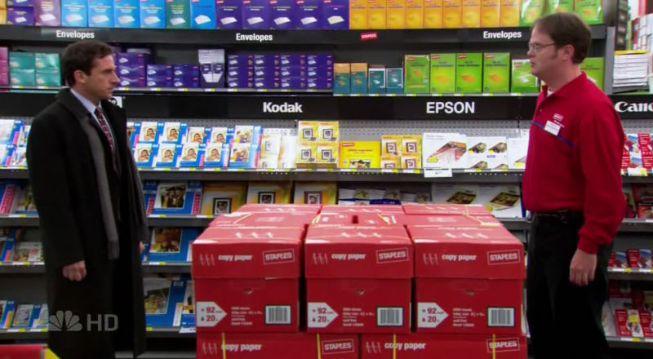
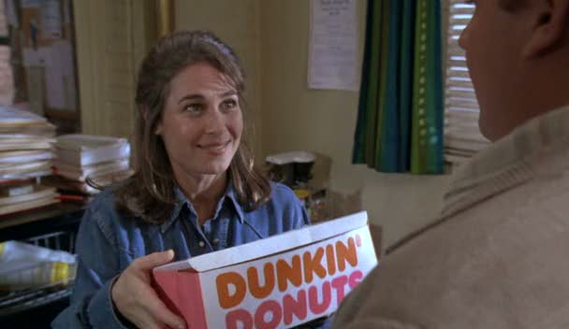
Consumer promotions cont.
Product placement

Slide 15
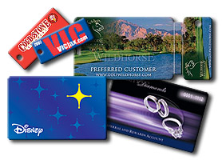
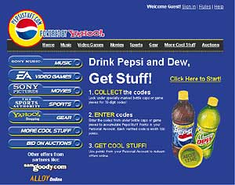
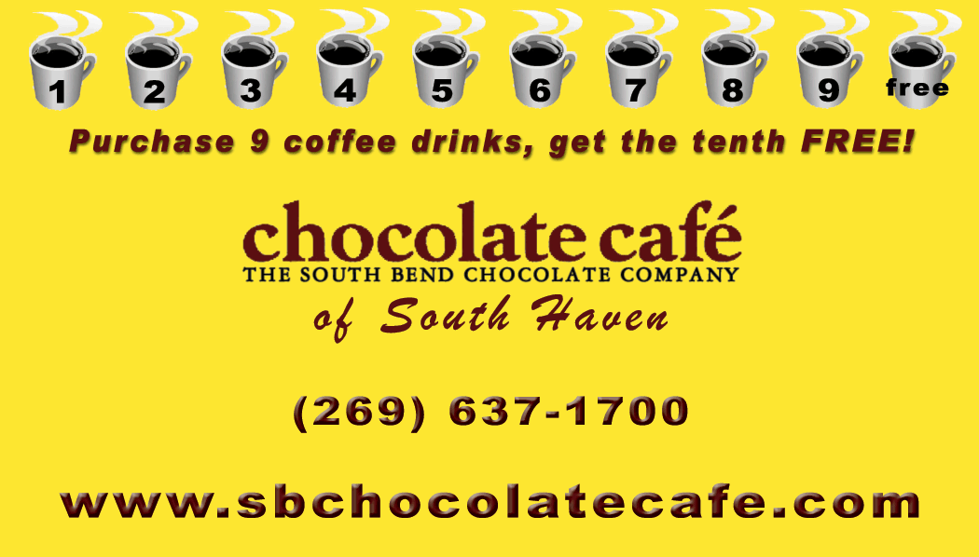
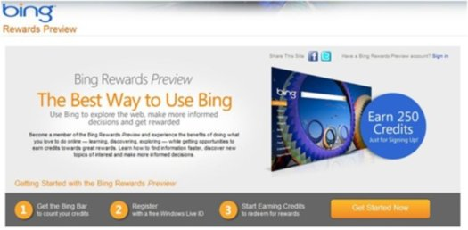
Consumer promotions cont.
Loyalty marketing programs
Online Loyalty

Slide 16
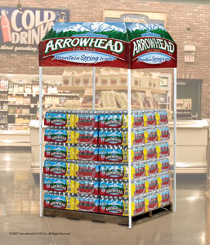
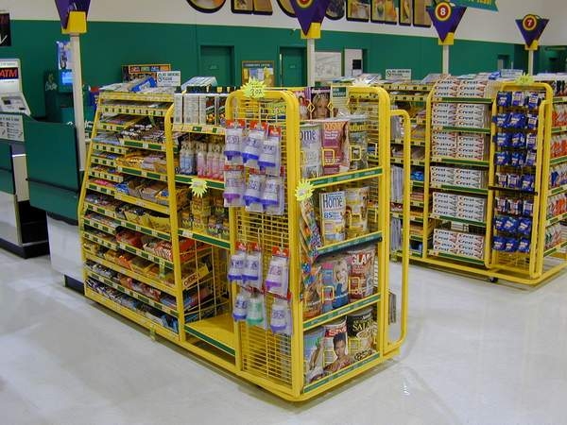
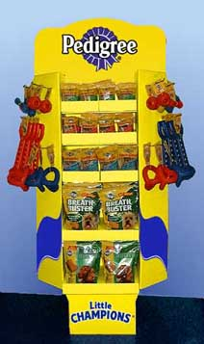
Consumer promotions cont.
Point of Purchase displays

