Slide 1
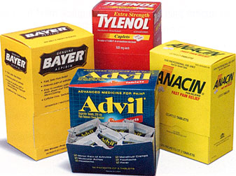
Types of Brands
National Brands
Generic Brands
Also known as producer brands
Owned by national manufacturers
Do not carry a company identity
Packaging describes item
Less expensive
Private Distributor Brands
Known as private brands, store brands, or private labels

Slide 2
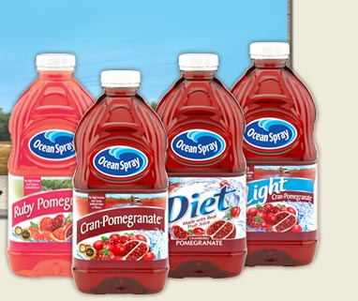
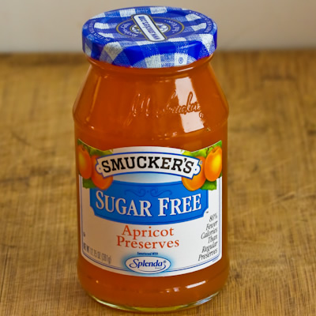
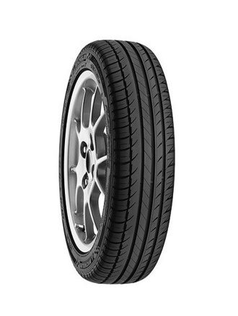
Branding Strategies
Brand Extension
Mixed Brands
Brand Licensing
Co-Branding
Uses an existing brand name to promote a new or improved product in a company’s product line
Offers a combination of manufacturer, private distributor, and generic brands to customers
Legally allows another company to use a brand, brand mark, or trade character for a fee
Combines one or more brands in the manufacture of a product or delivery of service

