Slide 1
Promotional Mix

Slide 2
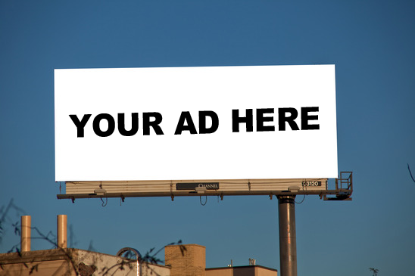
Advertising
NON-personal promotion
One-way communication
Mass audience
Internet – banner ads
Prize Winning Ads

Slide 3
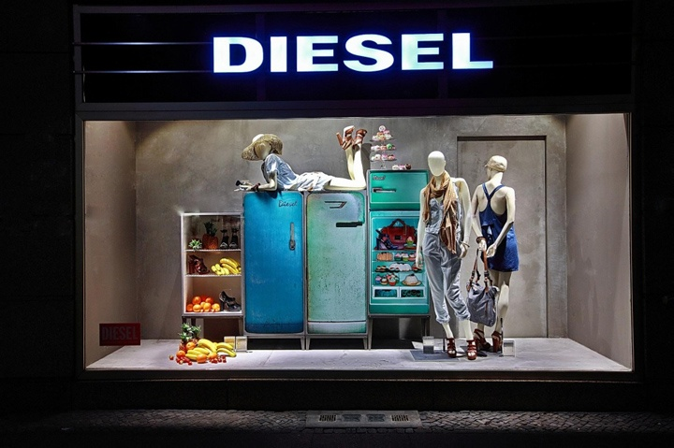
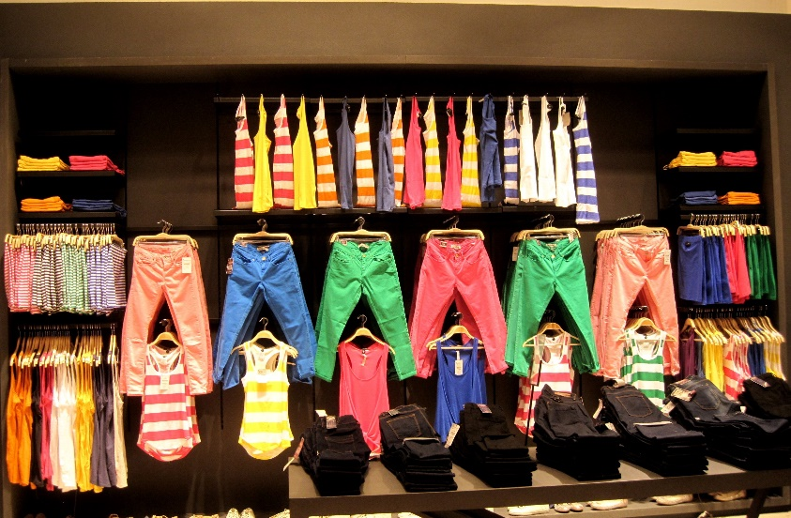
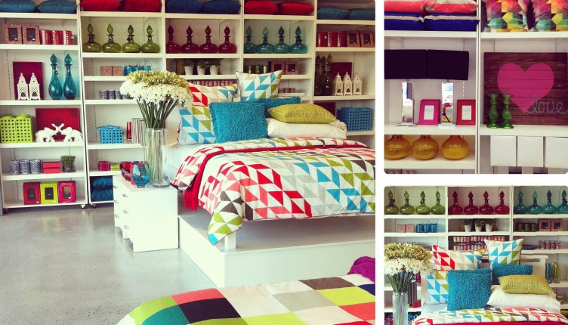
Visual Merchandising
Using artistic displays to attract customers into a store or to a product

Slide 4
Public Relations
Activities to help create a favorable image for a company
The goal of public relation efforts: To increase sales, reinforce a good reputation, and increase willingness of consumers to respond to advertising efforts for the company’s products.

Slide 5
Publicity is … Information, articles, or advertisements issued to secure public notice or attention. It’s the ink.
Publicity can be positive OR negative!

Slide 6
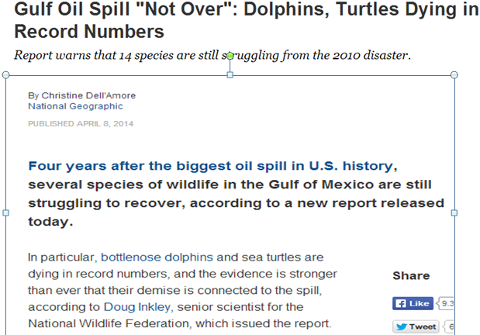
Examples:
Nature: Negative for BP
Target:
Community, Customers
Why is it publicity? This is publicity because it is an article explaining the long-term effects of a spill caused by a BP Rig

Slide 7
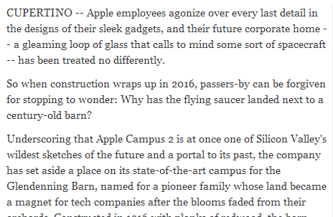
Examples:
Nature: Positive for Apple
Target:
Community, Customers
Why is it publicity? This shows that the heads of Apple are not just focused on making money, but keeping the community happy too!

Slide 8
Personal Selling
Sales Representatives generate & maintain direct contact with prospects
Planned and personalized communication to influence the buying decision of a prospect
B2B OR B2C!!

Slide 9
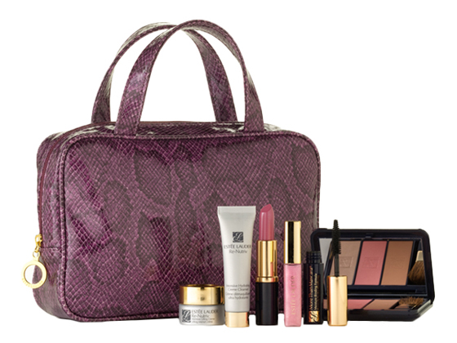
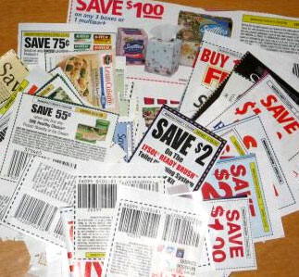
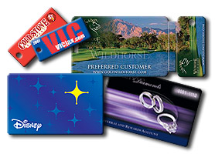
Sales Promotion
Short Term Activity or Buying incentive
Premiums
Coupons
Loyalty marketing programs

Slide 10
Social Network Marketing

Slide 11
Fuseideas

