Slide 2
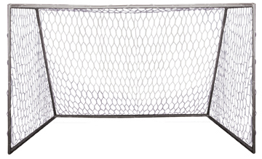
Pricing Goals
Build or Maintain Image
Maximize Profits
Increase Sales/Volume
Gaining Market Share

Slide 3
Pricing Strategies
Demand-based Pricing:
Most useful when consumers think your product/service is unique
A ‘one-of-kind’ item
What are people willing to pay
Competition-based Pricing:
Determine competitor’s price then decide: lower, higher, in-line
Cost-based
Based on the cost of product/service then decide amount of profit desired

