Slide 1
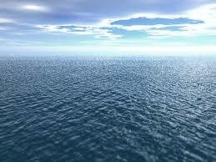
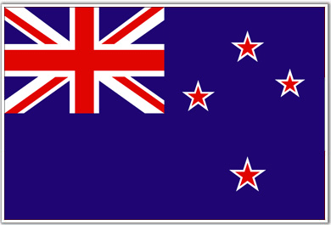
Ocean-Water Filtration System New Zealand
Emily Silverman

Slide 2
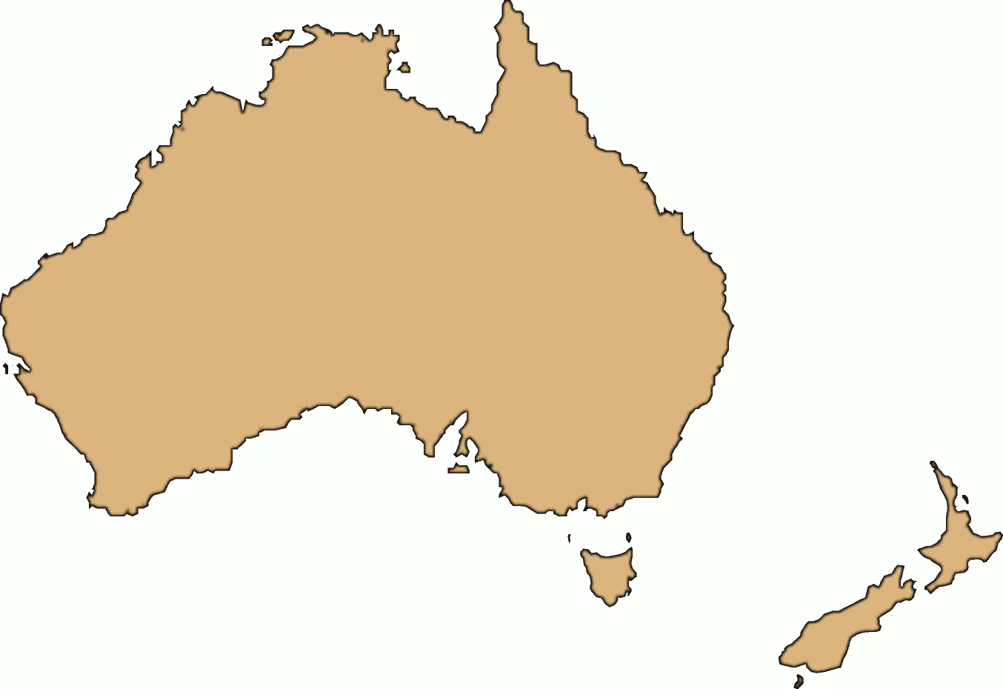
Geography/Environment
Island country (considered part of Australia)
Natural resources include a lot of fish
New Zealand Environmental Protection Authority (NZEPA)
Major concern: ocean pollution

Slide 3
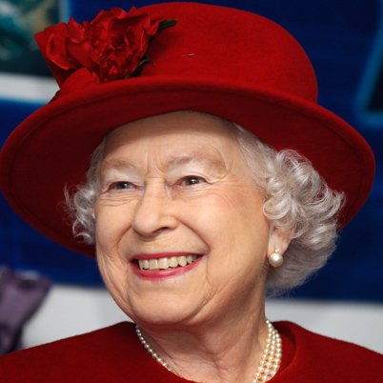
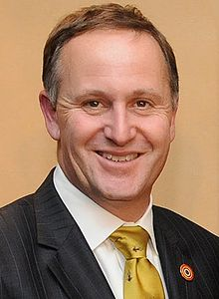
Politics
Gained independence from Great Britain in 1947
Democratically elected Prime Minister (John Key)
Queen Elizabeth 2 is head of state with little participation

Slide 4
Laws
Consumer: FTA protects consumers from deceptive actions/false representations
employment: holiday time, in wage, employment relations act for employees
Health/safety: emergency planning, identify/remove hazards
Competition: prohibits contracts or arrangements by firms that could lead to a substantial lessening of competition

Slide 5
Economy
National debt: 71.6 billion (USD)
Unemployment rate: 6.7%
GDP: 142.48 billion (USD)

Slide 6
Socio-Cultural
Close contact is important
6 meals a day
Holidays/ vacation time is important
Leisurely society
Well-educated
Live peacefully with indigenous people (Maori)

Slide 7
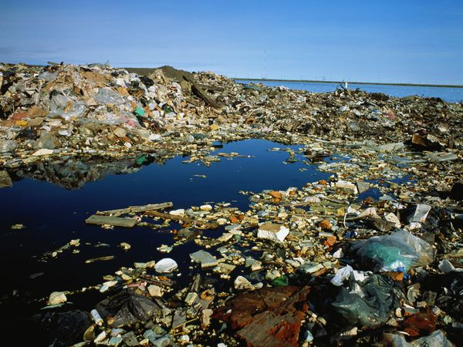
What do they need?
The Ocean-Water Filtration System!

Slide 8
Globalization
Reasons for product:
Stop water pollution
Protect sea life
Health benefits
Promotion:
Protection of water/animals
Health benefits for people

Slide 9
Marketing Strategy
Product:
The Ocean-Water Filtration System
Designed to filter pollution from water
Target market: NZ government

Slide 10
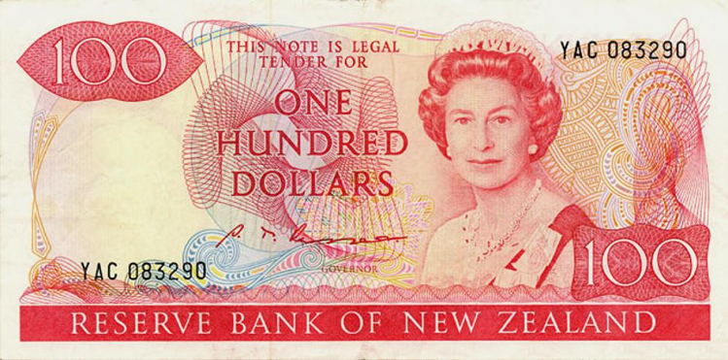
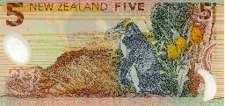
Marketing Strategy
Place: New Zealand/ South Pacific Ocean
Price: negotiate with government

Slide 11
Marketing Strategy
Promotion:
Face-to-face conferences/speeches to general public
Emphasize health/environmental benefits
Face-to-face meetings with Prime Minister and other governmental officials
Website www.owfs/newzealand.com
Twitter page @owfs/NZ

Slide 12
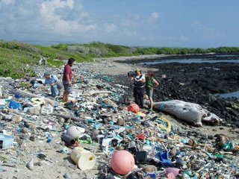
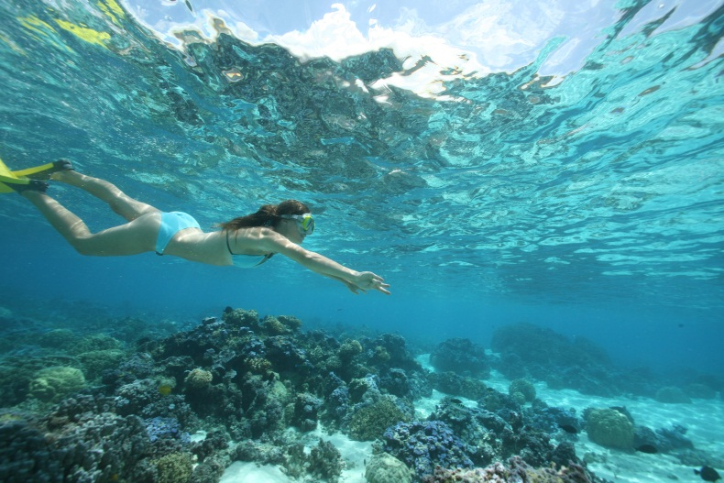
Conclusion
The Ocean-Water Filtration System
Sold to the New Zealand government
Promoted with globalization
Used to stop pollution, benefit the people’s health and protect wildlife

