Slide 1
Ireland CLEAN AND GREEN

Slide 2
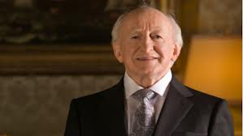
Politics
President elected to a 7 year term and cannot serve for me than 2 terms
Michael D. Higgins is currently president
8 regional authorities nominated
Neutral

Slide 3
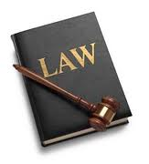
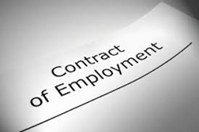
Laws and Obligations
Consumer laws; rights of consumer protected by Irish and EU laws
Competition laws; outlaw abuse of dominance, control mergers, acquisitions, joint ventures
Employment laws; part-time and full-time employees treated equally, workplace safety, unions, codes of conduct
Licenses and obligations vary however all ensure smoothness and fairness in business

Slide 4
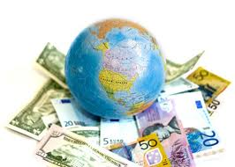
Economics
National debt: about $130 billion
Unemployment rate: approximately 15%
Gross domestic product: $272.3 billion
Unhealthy- recession
Use of the euro

Slide 5
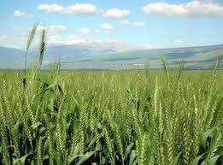
Agricultural Crops
Grains like wheat and barely
Vegetables; potatoes, sprouts, cabbage, cauliflower, carrots, turnips
Fruits; apples, plums, pears

Slide 6
Environment
850 native flowering plants
EPA ( Environmental Protection Agency)
front line of environmental protection and policing
Environmental concern: large littler problem

Slide 7
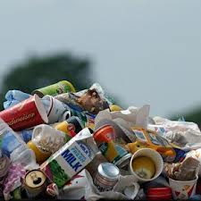
Litter in Ireland
Every year around 100 million spent on cleaning up litter
Government receives about 5,000 written complaints from tourists
Wildlife is being killed off
Litter is such a critical problem- soil that disintegrates it

Slide 8
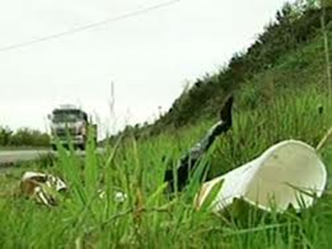
Litter Disintegratable Soil
Target market: Ireland’s government and Environmental Protection Agency, EPA
Product: soil that will break up and disintegrate litter
Place: Ireland
Price: 18,000 euros which is 23,720.40 US dollars

Slide 9
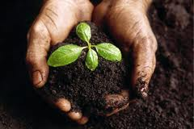
Promotion
Easy to promote because the problem is obvious
Clean and green environment
Beautiful landscape
Larger rate of tourism
Talk to government directly
Website

Slide 10
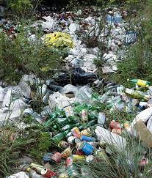
Customization
Invented for Ireland b/c of their high litter rate
Easy to promote- obvious litter problem
Eventually adaptation- other nations who struggle with litter
Adapted to their climates

Slide 11
Competition, Advantages, Obstacles
Eventually companies may begin to create their own version of this soil
US will lose money- cheaper to get from own country
Little to none competition
US will be only suppliers
Since product is so necessary to Ireland’s environment, US can raise prices
Showing the necessity to Ireland

Slide 12
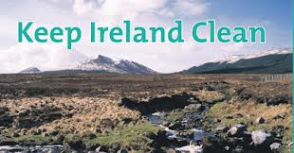
Conclusion
Crops and tourism is important to Ireland
Wildlife being killed
100 million spent on littler clean up- soil more cost effective
GO GREEN!

