Slide 1
Marketing Your Product/Service

Slide 2
Marketing Goals
1. Brand recognition
Increase number of customers
Market Share

Slide 3
Market Share
The percentage of a given market population that is buying a product or service

Slide 4
The Marketing Mix
Strategies

Slide 5
People
Detailed Customer Profile
Who is the target market for YOUR business?

Slide 6
Product
What item(s) or service(s) can your business offer that will best meet the needs of the your target market?

Slide 7
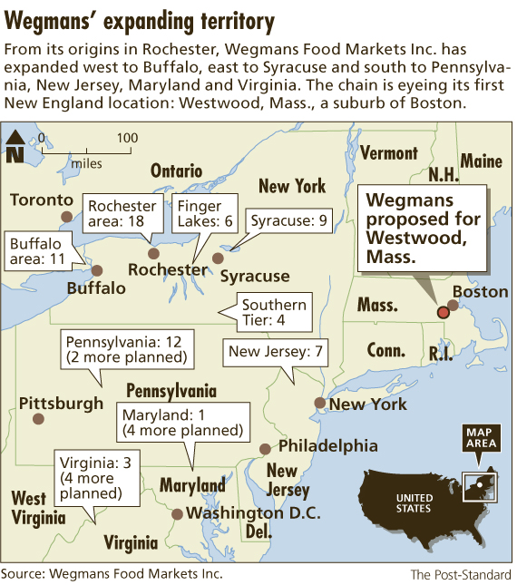
Place
How & where will your will customers buy your products or receive your services?

Slide 8
Price
What costs do you incur?
How much profit do you want to make?
What will people pay for your product or service?
What is your competition charging?

Slide 9
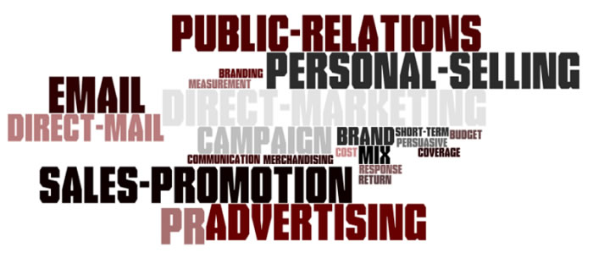
Promotion
The process to make your customers aware of your product/service

Slide 10
What are the 5 P’s for the following companies??

