Slide 1
Determining Place (distribution) Strategies

Slide 2
Distribution Channels
Direct Distribution
Indirect Distribution
From producer /manufacturer to the consumer
Examples?
Product goes from producer through one or more intermediaries before reaching consumer

Slide 3
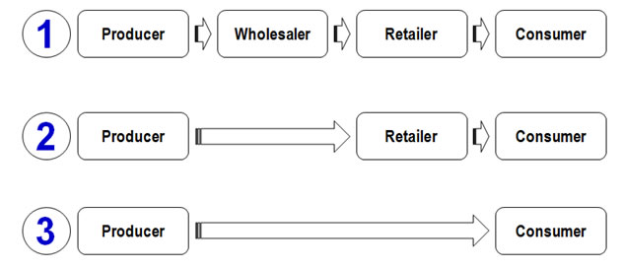
Indirect Distribution

Slide 4
When and where will you sell?
Choosing an excellent location for your store
Determining the days and hours when customers are more likely to shop
Providing an easy-to-use website that customers can access any time from any location

Slide 5
Type of Distribution Strategy
Exclusive
Gives a specific retailer or authorized dealer the sole right
Ex: Craftsman tools - - only at Sears
Intensive
Available in as many distribution outlets as possible
Ex: Chewing gum – grocery stores, drug stores, gas stations, vending machines
Selective
Moderate # of sales outlets
Ex: Car dealers, only if they have room; not keeping extra inventory

